Slide 1

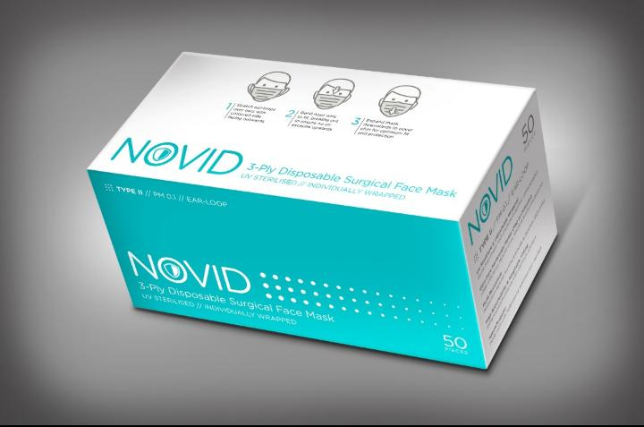
A New Paradigm Shift
Notion VTec Bhd Q2 FY2020 Results
Dated
4 June 2020

Slide 2

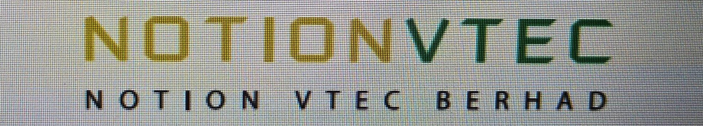
Caveat Emptor Applies:
This is not investment advice but business outlook with unaudited forward projections meant for presentational purposes not for making investment decisions. Investors please seek professional advice for buying and selling decisions. Investment in stocks is risky.

Slide 3


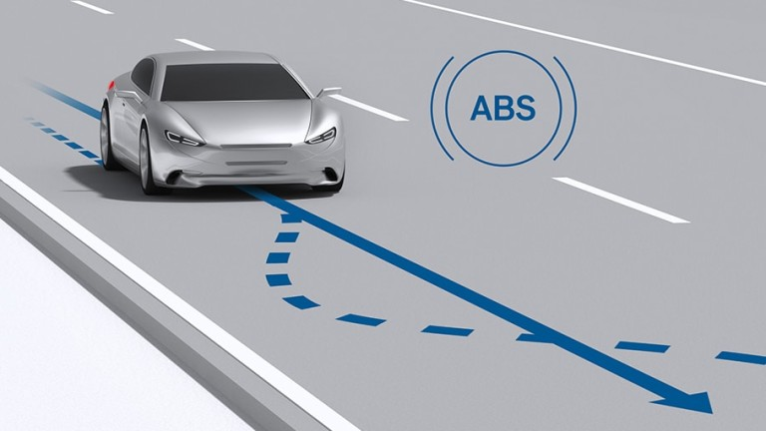
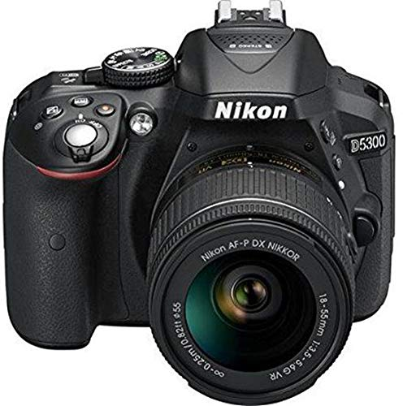
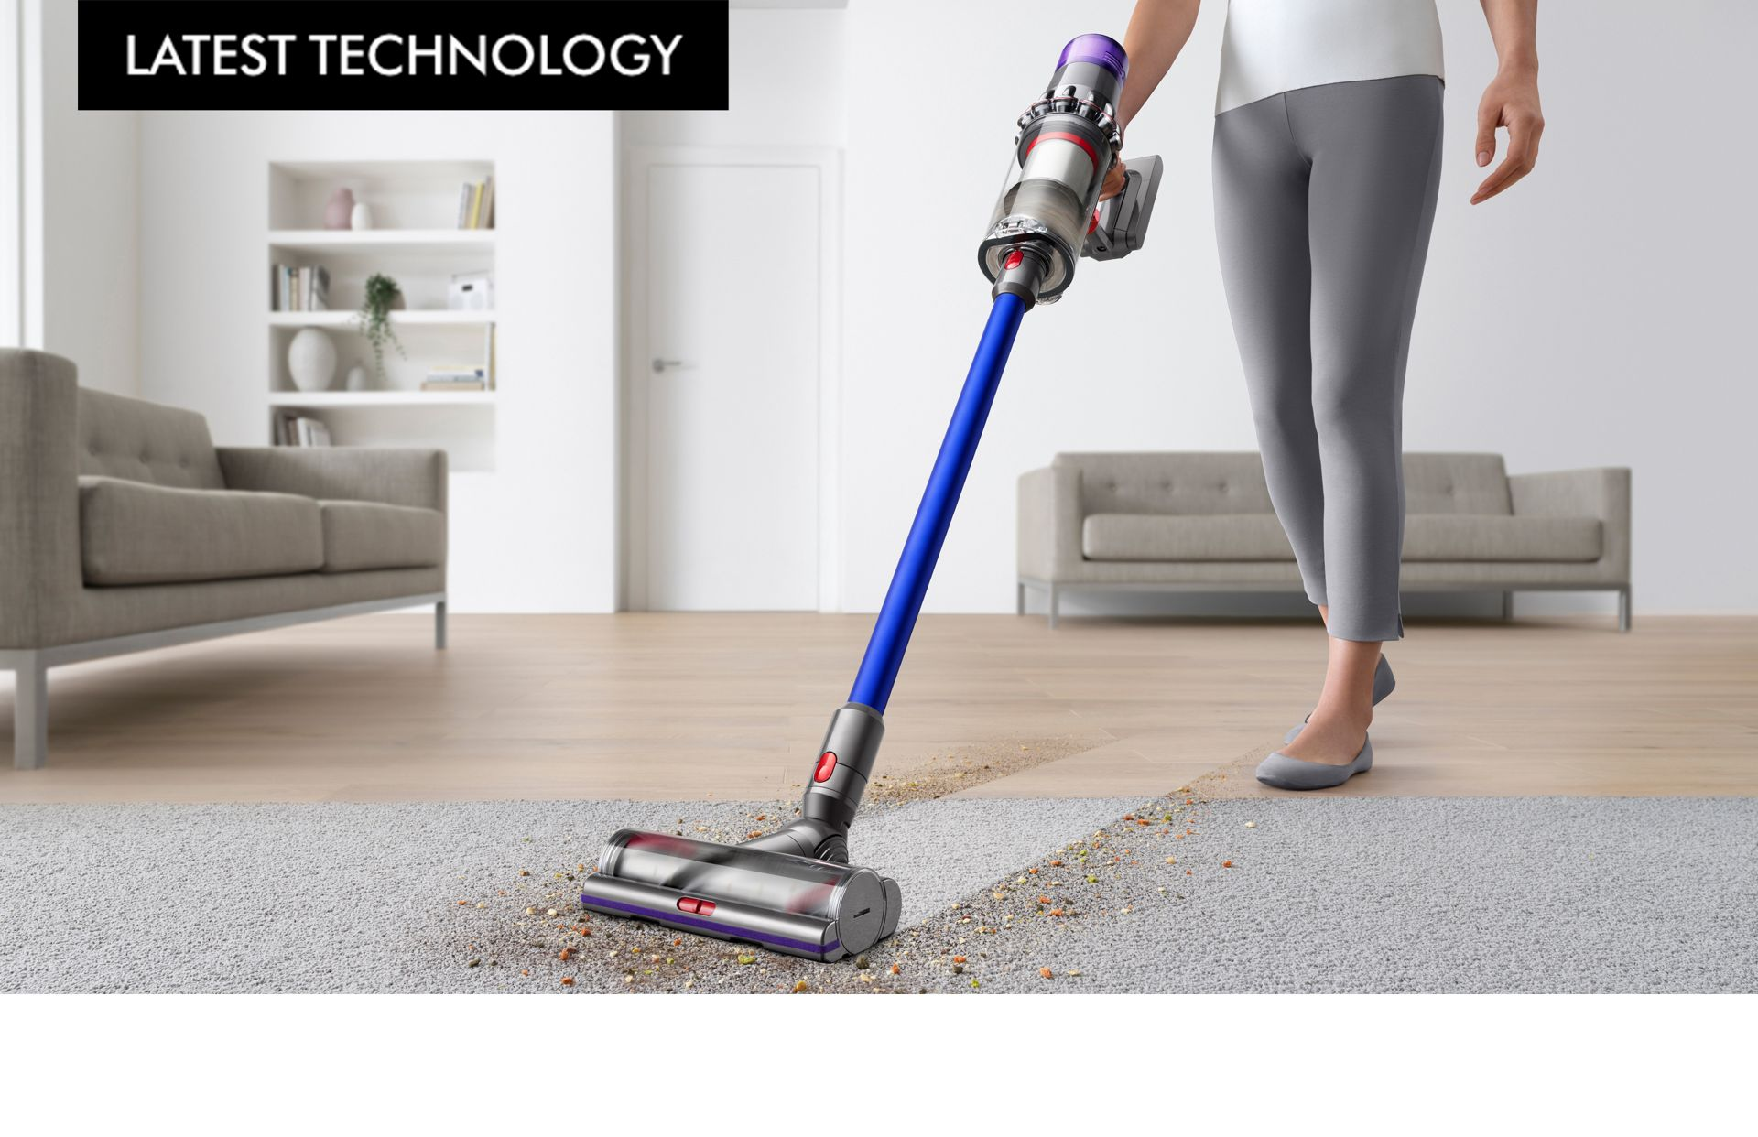
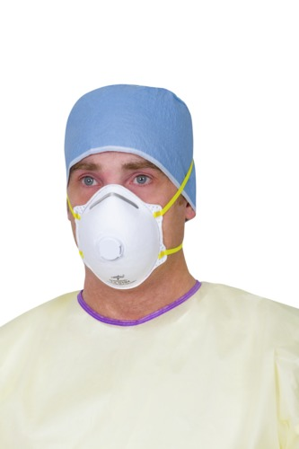
About Us
HDD
Automotive
Notion’s approach to business strategy:
Diversification of industries & customers in high volume manufacture.
Integrated manufacture.
Scalable business.
Camera
EMS
We are a diversified precision engineering and manufacturing group of companies mainly in HDD, Automotive, Camera & EMS and Healthcare Products
Healthcare products

Slide 4
QoQ Comparison RM’mils
 | Q2 FY2020 | Q1 FY2020 | Q4 FY2019 | Q3 FY2019
Revenue | 62.3 | 70.3 | 65 | 56.4
COGS | (58.2) | (55.6) | (49.4) | (48)
Gross Profit | 4.0 | 14.7 | 15.6 | 8.0
Other Op Profit | 4.5 | 16.0 | 12.0 | 1.9
Other Op Expenses | (11.0) | (11.8) | (11.7) | (7.7)
Operating Profit/Loss | (2.4) | 18.9 | 15.8 | 2.2
Finance cost | (1.1) | (1.1) | (1.2) | (1.3)
Profit/Loss before Tax | (3.5) | 17.8 | 14.6 | 0.9
Tax | (0.2) | (3.6) | (2.5) | 0.9
Profit/Loss after Tax | (3.7) | 14.2 | 12.1 | 1.8
Insurance Claims | NA | 12.2 | 10 | NA
Net Profit excl Insurance Claims net of tax | (3.7) | 5.1 | 4.6 | 1.8

Slide 5
Rolling Quarter on Quarter Comparison
70.3 mil
62.3 mil
56.4 mil
5.1 mil
4.6 mil
1.8 mil
(3.7) mil

Slide 6
Comparison of Segments
Segmental (RM millions)
Q2 FY2020
Q1 FY2020
Segment | RM’millions
HDD | 27.6
Automotive | 25.4
Camera | 5.0
EMS | 12.2
Total | 70.3
Segment | RM’millions | % change
HDD | 24.9 | -10%
Automotive | 22.4 | -12%
Camera | 3.0 | -39%
EMS | 11.8 | -3%
Total | 62.3 | -11%

Slide 7
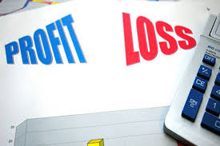
Reasons for Losses in Q2
Under utilised capacity: under-absorption of overheads to COGS of RM7.3 mil
Additional purchase of aluminium billet for extrusion startup of RM0.4 mil
3. Additional renovation cost on face mask production of RM0.4 mil
4. Loss of orders contributions due to China supply chain disruption to customers and contract manufacturers
Minimum wage increase on 1 Jan 2020 resulting in RM0.9 mil
Total costs charged to COGS: RM9 mil

Slide 8

A Quantum Leap Strategy
Notion has embarked instead of an incremental to a quantum leap strategy

Slide 9
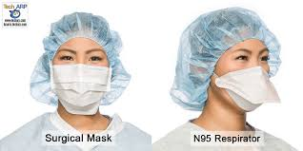
3 Ply Surgical and N95

Slide 10

Healthcare Products Investments
Long term investments in:
Surgical 3 ply face mask
Medical 4 or 5 ply face mask/respirator N95
PP MB fabric filter production
PP resin additive production as feed stock to PP MB
Later PP spunbond (SB) production
Capacity:
3 ply of 10 million pcs per month (by end June)
PP MB of 50 tons per month sufficient for 50 million pcs of face mask (by end July)
Local and export markets
Capex RM7.5 mil

Slide 11

Why wearing a Face Mask is a new norm?
What is driving this industry:
Panic buying
China imported face mask/respirators as its face mask output was 20 mil a day.
Current output 120 mil face mask a day
Chinese workers of 560 mil need daily 400 mil face masks, the sustainable daily demand is 150 mil
The global daily demand for masks will reach hundreds of millions from the rest of the world also
Face mask demand and production is explosive in 2020 and taper off in 2021. Experts warned of 2nd and 3rd waves. If that happens the demand will remain high
The speed of the contagion of Covid-19 is exponential not allowing time for government healthcare system to stockpile PPE which includes surgical mask and N95 respirators
USA is stockpiling 300 mil N95 respirators, LA hospitals is stockpiling 24 mil N95 masks and UK is building stock of 70 mil N95 respirators over the next 15 months.
3 main mask demands: by the exposed healthcare personnel, the fearful public (reducing risk of virus transmission) and stockpiling (for future outbreaks)
Face Mask will follow the way of Hand Gloves Demand

Slide 12

Face Mask will follow the way of Hand Gloves?
Market is divided into:
1) N95 respirators & 3 ply surgical for healthcare staff and doctors, testing staff, front-liners
2) 3 ply surgical face masks for the general public
Social distancing will stay for a long time and wearing a face mask reduces risk of virus transmission as many countries have made it mandatory
Hand gloves are used mainly in healthcare industry and food handling vs face mask is used also by public. Both are considered as sanitation products
Major countries will stockpile for any eventualities and move away from China being main source of supply due to some rejection of masks & respirators, price gouging and insufficient supply during a pandemic
There will be a steady baseline demand for high quality N95 in hospitals and healthcare centres and in many countries wearing a cheaper 3 ply face mask will be a growing habit

Slide 13

A Quantum Leap Strategy
In the healthcare business sector, there are a couple of directions we can expand:
Expand 3 ply surgical mask output
Convert to exporting surgical mask
Start medical N95 grade mask/respirators for export
Expand PP meltblown output
Start PP resin additive production
Start PP spunbond and spunlace fabric
Develop other non-Healthcare applications
Post the lockdown, opportunities for stockpiling orders

Slide 14

Notion: Healthcare Products Revenue
Assumptions:
Face mask 3 ply we assume RM1 a unit price
PP MB we assume USD50,000 a ton
Revenue each month:
3 ply face mask max revenue of 10 mil pcs using 10 tons PP MB a month: RM10 million
PP MB max revenue on balance 40 tons a month: USD2 million or RM8.7 million
Total face mask + PP MB sales a month: RM18.7 million in Q4 FY2020
Next stage expansion before FY2021: Additional 50 tons PP MB a month giving sales of RM10.9 mil
So Healthcare Products in FY2021 est sales RM29.6 mil a month

Slide 15

Notion: Key expansion Catalysts next 3 months:
3 or 4 ply face mask expansion of 16 mil pcs a month: RM16 mil potential sales
PP meltblown expansion of 50 tons or more: RM10.9 mil potential sales
N95 respirators expansion of 2 mil pcs a month: assume RM4 a piece:
Potential RM8 mil sales
Total potential sales of 3 catalysts: RM34.9 mil a month

Slide 16

Conclusions of New Paradigm Shift Strategy
Metals business + new Healthcare Products. Common: automated machines and high volume & quality manufacture. A new Paradigm Shift
HDD growth sector for now, the EMS and Automotive sectors recovery in late 2021 but HDD spacer growth is limited by competition and change to titanium/stainless steel
Post pandemic, autonomous electric cars (social distancing factor) and need for braking parts and camera sensors opportunities
The PP melt-blown fabric production: non-Healthcare applications HEPA filters &
cars and water filters
Notion is building a new economic moat. Healthcare target net margin 15 to 20%

Slide 17





Thank You
Thoo Chow Fah
Executive Chairman
Notion VTec Bhd
www.notionvtec.com

