Slide 1

After 3 years, IQOS project in hand
Notion Vtec Bhd: Q4 FY2020 (Jul to Sep) Presentation: Additional Update News
26 November 2020

Slide 2

Small Win but significant impact
EMS segment will be augmented by 30+% through IQOS project contribution from Q2 FY2021

Slide 3
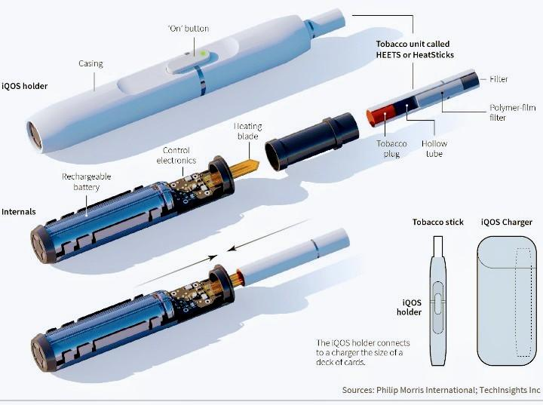
EMS grows
Since 2017, Notion has been following on this IQOS project and delayed by the fire disruption in 2017
Finally secured contract to supply the middle aluminium part called Hollow Tube

Slide 4
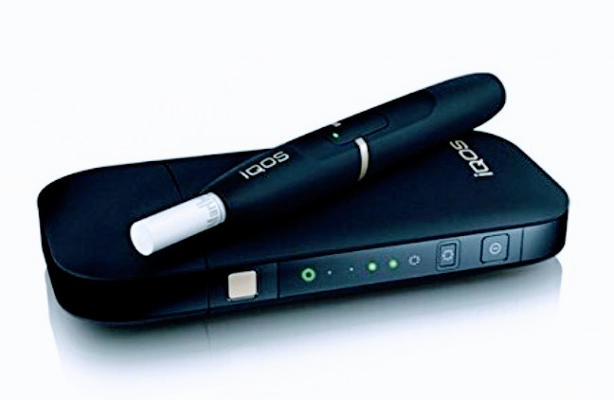
What is IQOS?
NEW SMOKELESS e CIGARETTE
Tobacco heating system created by Philip Morris
3 parts:
A heated tobacco unit
Holder
A charger

Slide 5
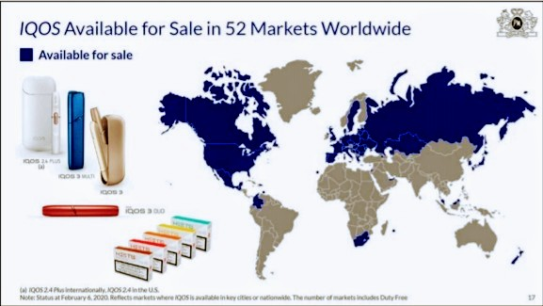
IQOS in 52 markets
Still more room to grow

Slide 6
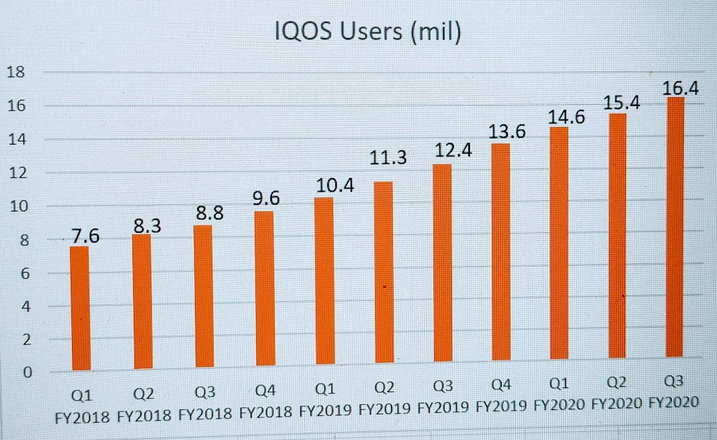
IQOS users growth QoQ
Steady growth as more are converted from combustible tobacco users
Lifestyle attraction
Safer smoking option
More device models in future

Slide 7
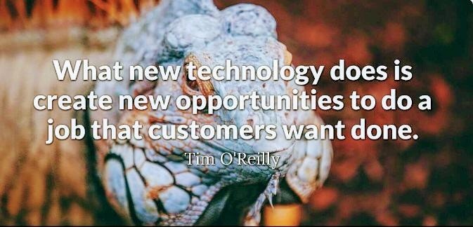
Notion focuses Technology
PPE business a much needed diversification during a pandemic created recession
Technology is main stay of the Notion Group
THANK YOU

